Slide 1

Mini Project-SQL
TITLE – ‘ICC Test Cricket’
Presented By – 1) Rupal Sanjay Nikum
2) Gayatri Jitendra Patil
3) Yadnesh Subhash Joshi
4) Suyog Ghadge
5) Atharva Mahesh Shastri

Slide 2
Problem Definition
Part -A
Dataset -:
The ‘ICC Test Cricket’ dataset consist all the required data of runs scored by the batsmen from 1877 to 2019 December.
Problem statement -:
‘ICC Test cricket’ dataset aim is to choose right player by examining its previous records that are mentioned in given dataset. To analyze the player performance in the ICC.

Slide 3
Dataset Description :
Sl No | Column Name | Column Description
1 | Player | Name of the player and country the player belongs to
2 | Span | The duration of years between which the player was active
3 | Mat | No of matches played by the player
4 | Inn | No of innings played by the player
5 | NO | No of matches the player was NOT OUT by the end of the match.
6 | Runs | Total number of runs scored by the player
7 | HS | Highest Score of the player
8 | Avg | Average runs scored by the player in all the matches
9 | 100 | No of centuries scored by the player
10 | 50 | No of fifties scored by the player
11 | 0 | No of Duck outs of the player
12 | Player Profile | Link to the profiles of the players

Slide 4
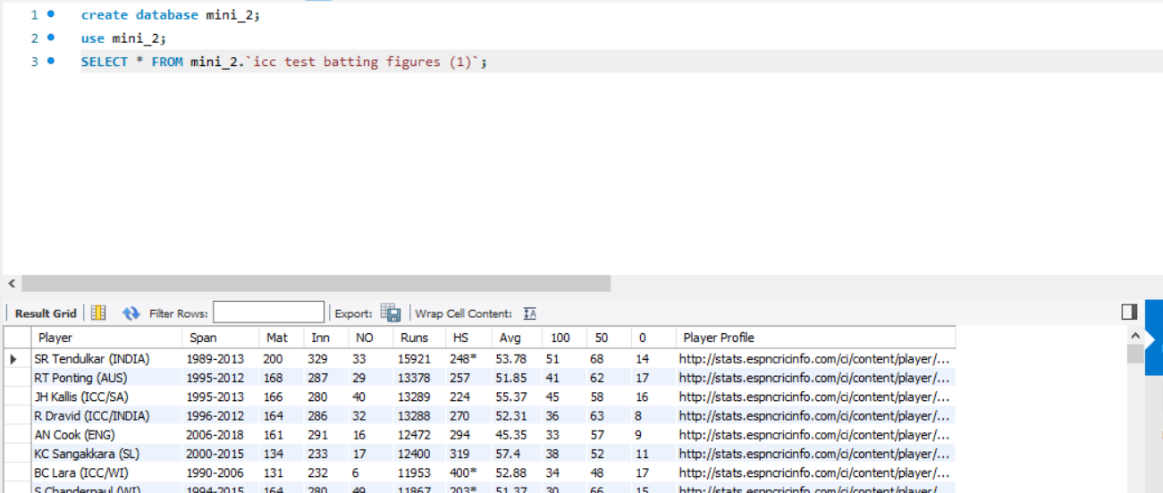
Project Flow: Question 1 - :Import the csv file to a table in the database. Code – :use icc_test_cricket; show tables; Solution-: Firstly created database . Then imported the csv_format file icc_test_cricket. Inference- :We get following output after importing dataset.

Slide 5
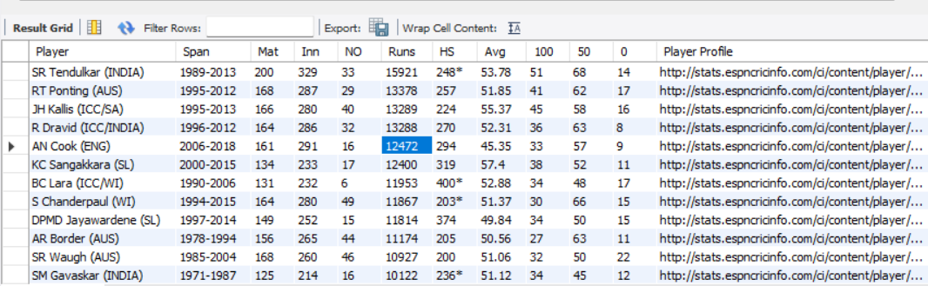
Project Flow Question 2 - Remove the column 'Player Profile' from the table. Code – alter table `icc test batting figures (1)` drop column `Player Profile`; Solution- For removing column we use ‘drop’ function it helps to delete the column. Inference- After using the drop command the column get dropped from the table.

Slide 6
Project Flow Question 3 - Extract the country name and player names from the given data and store it in separate columns for further usage. Code – alter table `icc test batting figures (1)` add column country varchar(45); alter table `icc test batting figures (1)`add column Name varchar(100); select substr(player,instr(player,"(")+1,(instr(player,")")-instr(player,"("))-1) as 'Country' from `icc test batting figures (1)`; update `icc test batting figures (1)` set country=substr(player,instr(player,"(")+1,(instr(player,")")-instr(player,"("))-1); update `icc test batting figures (1)` set name=left(player,instr(player,'(')-1);

Slide 7
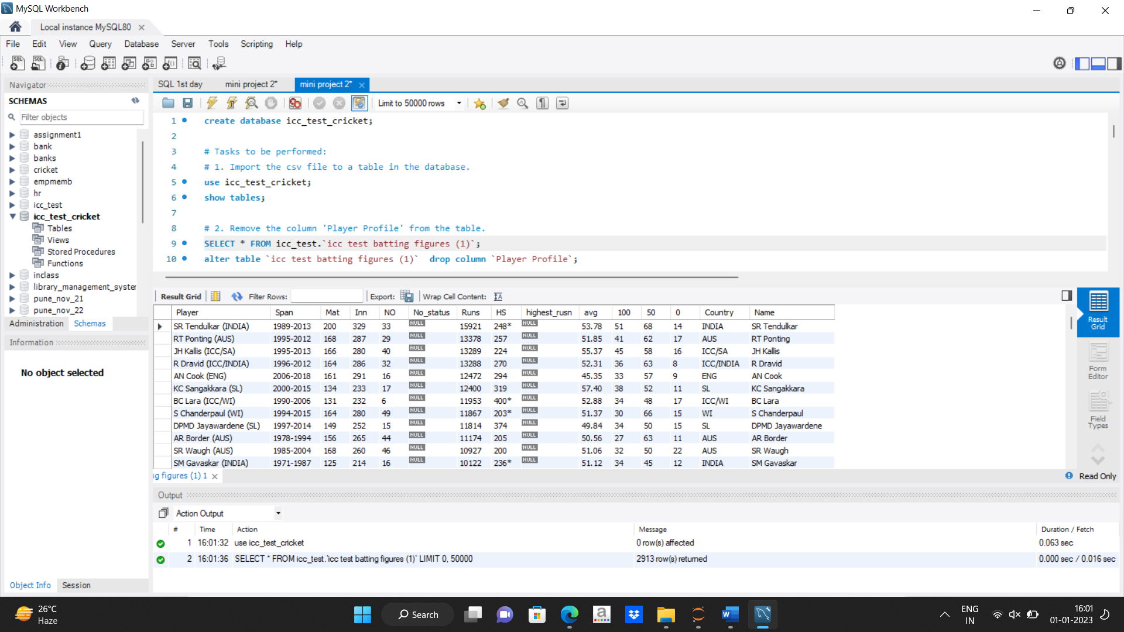
Solution-: In the first step using alter command we added the column country,name in the table. In a second step using substring and in-string function we find the position of the ‘(‘ and separated column using the command . After separating the column we get temporary result that can be store in the column country, name using the update command. Inference:- We get separated output after using the step. We get new columns names, country.

Slide 8
Project Flow Question 4 -: From the column 'Span' extract the start_year and end_year and store them in separate columns for further usage. Code – : alter table `icc test batting figures (1)` add column start_year int; alter table `icc test batting figures (1)` add column end_year int; select substr(span, 1,4 ) as start_year, substr(span, 6, 9) as end_yearfrom `icc test batting figures (1)`; update `icc test batting figures (1)` set start_year=substr(span, 1,4 ), end_year=substr(span, 6, 9) ; Solution-: In first step we have created columns start_year and end_year using alter command. In second step we use substring function to separate the year from the table. Using the update command we have updated the output in the table.

Slide 9
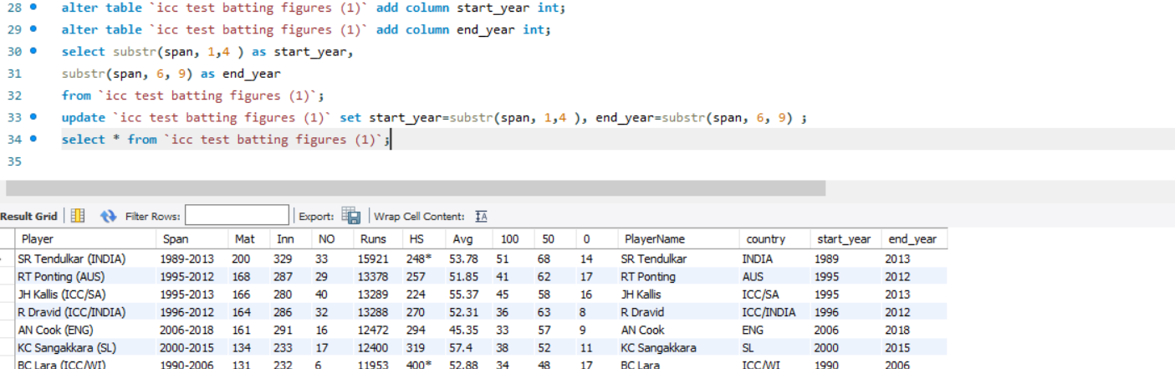
Inference-:
We get separated output using the substring command and added the columns in the table. Using the update command the separated output get store in the columns respectively.

Slide 10
Project Flow Question 5 - The column 'HS' has the highest score scored by the player so far in any given match. The column also has details if the player had completed the match in a NOT OUT status. Extract the data and store the highest runs and the NOT OUT status in different columns. Code – alter table `icc test batting figures (1)` add highest_rusn int after hs, add No_status varchar(20) after NO; Update `icc test batting figures (1)` set hs = 0 where hs = ‘ '; select substr(hs, 1, if (locate('*', hs ), locate('*', hs) -1, hs))highest_runs, if (locate('*', hs), 'Not out', 'Out') No_status from `icc test batting figures (1)`; Update `icc test batting figures (1)` set Highest_runs = substr(hs,1,if(locate('*', hs),locate ('*', hs) -1, length(hs))),No_status = if (locate('*', hs), 'NOt out', 'out');

Slide 11
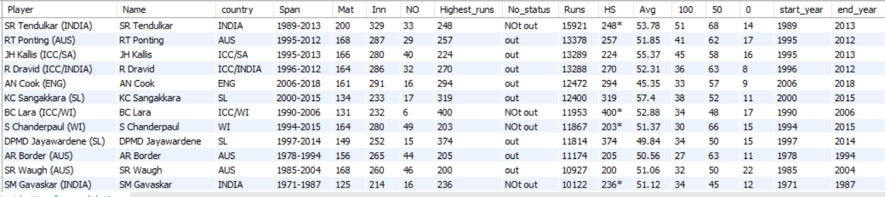
Solution- :
In first step we added the column in the table using the alter command.
Using the update command we updated the hs column.
In second step using substring function we get the separated output.
The separated output is get updated using the update command .
Inference-: We get separated output in the table.

Slide 12
Project Flow Question 6 -: Using the data given, considering the players who were active in the year of 2019, create a set of batting order of best 6 players using the selection criteria of those who have a good average score across all matches for India. Code -: update `icc test batting figures (1)` set avg = 0 where avg = ' '; alter table `icc test batting figures (1)` modify avg decimal (6,2); select * from `icc test batting figures (1)`;select name, avg ,row_number() over() as batting_orderfrom `icc test batting figures (1)`where end_year = 2019 and country in ('INDIA', 'ICC/INDIA')order by avg desclimit 6; Solution-: In the first we have updated the avg column where value is null add the value 0 to it. We have modify the avg column upto decimal (6,2) using the modify command. Using the over() clause and window function row_number we have set the batting order by giving the sr.no.

Slide 13
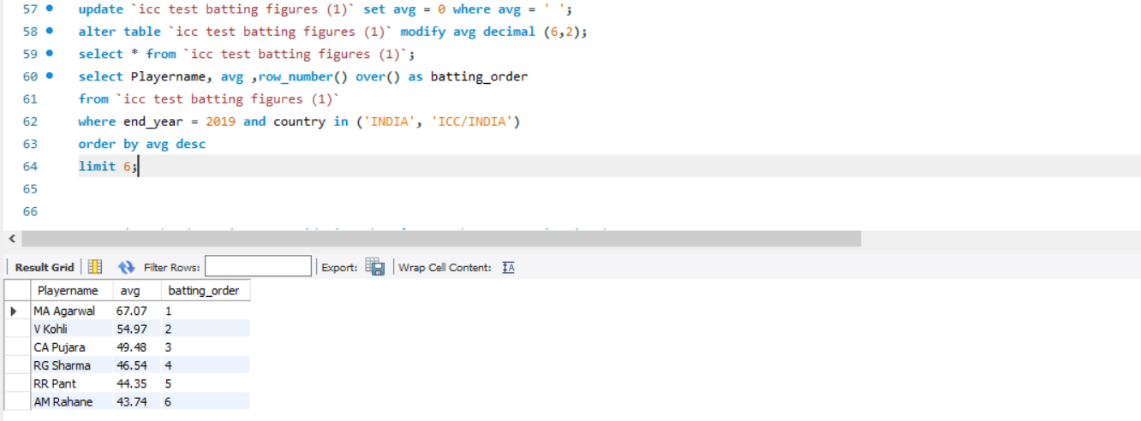
We have sort the active player in the year 2019 using where clause.
It will give the list of player which are active in the year 2019 and played for ‘India/
ICC’. The best player list is sorted by the criteria that the player have highest batting
Average for playing team ‘India’. We have order the player using the criteria.
Inference-:
We get the sorted output with highest batting average for the player who played for
India.

Slide 14
Project Flow Question 7 - Using the data given, considering the players who were active in the year of 2019, create a set of batting order of best 6 players using the selection criteria of those who have the highest number of 100s across all matches for India. Code – update `icc test batting figures (1)` set `100` = 0 where `100` = ' '; alter table `icc test batting figures (1)` modify `100` int; select name, `100` ,(row_number() over ()) as Batting_orderfrom `icc test batting figures (1)` where end_year = '2019' and country in ('INDIA', 'ICC/INDIA')order by `100` desclimit 6; Solution-: In the first step we have updated the `100` column where the value is null add the value 0 to it. Using the over() clause and window function row_number we have set the batting order by giving the sr.no.

Slide 15
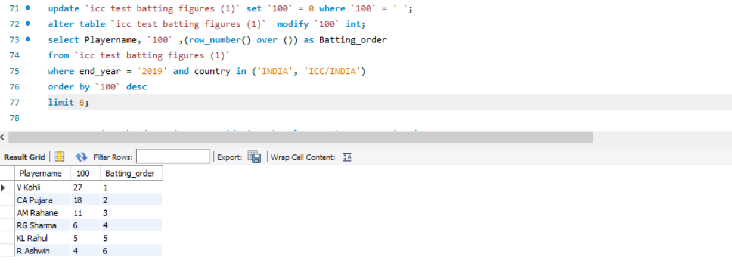
We have sorted the active player in the year 2019 using where clause.
It will gives the list of player which are active in the year 2019 and played for ‘India/ICC’.
The best player list is sorted by the criteria that the player have hit the
More century in ICC for playing team ‘India’. We have order the player using the criteria.
Inference-:
We get the sorted output with more century hit by the player for team
India.

Slide 16
Project Flow Question 8 - :Using the data given, considering the players who were active in the year of 2019, create a set of batting order of best 6 players using 2 selection criteria of your own for India. Code - : select name,`50`, `100` ,(row_number() over ()) as Batting_order from `icc test batting figures (1)` where end_year = '2019' and country in ('INDIA', 'ICC/INDIA') and avg>40 and `50`>1order by `100` desc limit 6; Solution-: We have get the column 50,100 from table ‘ icc test batting figures (1)’. Set the selection criteria for the player that are active in the year 2019,palyed for the country(India) with an average greater than 40 and hit atleast one fifty for team in 2019 in the where clause. Set batting order by using the over clause and window function with selection criteria.

Slide 17
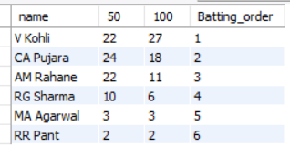
Inference-:
We get batting order with respect the selection criteria for the team India.

Slide 18
Project Flow Question 9 -: Create a View named ‘Batting_Order_GoodAvgScorers_SA’ using the data given, considering the players who were active in the year of 2019, create a set of batting order of best 6 players using the selection criteria of those who have a good average score across all matches for South Africa. Code - : create view Batting_Order_GoodAvgScorers_SA as ( select name, avg, row_number() over() as Batting_orderfrom `icc test batting figures (1)`where end_year = 2019 and country='SA' order by avg desclimit 6); Solution-: To crate view we use the command create view which is DDL command. Set selection criteria for the team South-Africa with a good average score across all matches for South Africa and player active in year 2019 using the where clause. By using the window function row_number and over clause for generating the best player batting.

Slide 19
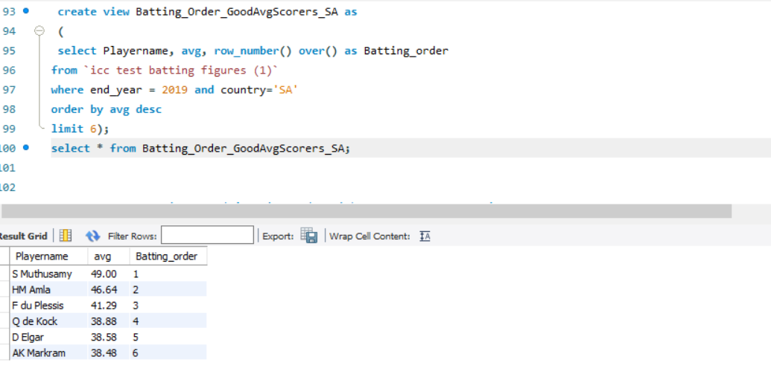
Inference-:
We get batting order with respect the selection criteria for the team South-Africa.
We get the view of the ‘Batting_Order_GoodAvgScorers_SA’ .

Slide 20
Project Flow Question 10 - :Create a View named ‘Batting_Order_HighestCenturyScorers_SA’ Using the data given, considering the players who were active in the year of 2019, create a set of batting order of best 6 players using the selection criteria of those who have highest number of 100s across all matches for South Africa. Code - : create view Batting_Order_HighestCenturyScorers_SA as (select name,`100`,row_number() over() from `icc test batting figures (1)`where end_year=2019 and country= 'SA'order by `100` desc limit 6); Solution-: We have created view with name ‘Batting_Order_HighestCenturyScorers_SA’. Set the selection criteria for the player which are active in year 2019 and hit the more highest number of 100s across all matches for South Africa. By using the order by clasue set there order with selection criteria.

Slide 21
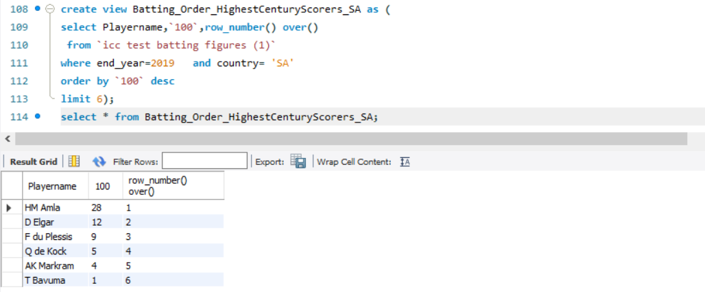
Inference-:
We have get the current view of the table ‘Batting_Order_HighestCenturyScorers_SA’.
The sorted view of the best player played for country South-Africa with highest
Number of century hit by the player.

Slide 22
Project Flow Question 11 -: Using the data given, Give the number of player_played for each country. Code - : select country,count(name)from `icc test batting figures (1)`group by country ; Solution-: We have use aggregate function count to give = the total number of player played for the each country. By using group by clause we get count for the player_played for each country. Inference-: We get total count of player played for there nation in ICC tournament by each country.

Slide 23
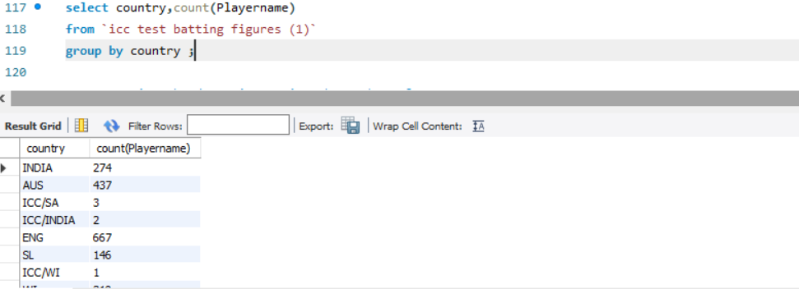

Slide 24
Project Flow Question 12 - :Using the data given, Give the number of player_played for Asian and Non-Asian continent. Code -: select country ,count(name) as player_played_for_Asian from `icc test batting figures (1)` where country in ('WI','AUS','Eng','NZ','ZIM','IRE','SA') group by country; select country , count(name) as player_played_for_Nonasian from `icc test batting figures (1)` where country in ('India','Pak','SL','BDESH','AFG') group by country; Solution-: We get the count of player played for the Asian continent in the ICC tournament with respect to the country which include in the Asian continent. For the non-Asian continent player which are played in ICC tournament for there country we use the same logic for it.

Slide 25
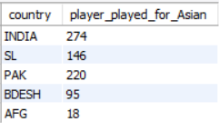
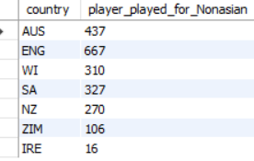
Inference-:
We get the two output for the total player played in the ICC tournament one for the player_played for the Asian continent and another one is for player_played
For non-Asian continent.

Slide 26
Part – B
Dataset:
“Richard’s Supply” is a company which deals with different food products.
The company is associated with a pool of suppliers.
Every Supplier supplies different types of food products to Richard’s supply.
This company also receives orders for the food products from various customers.
Each order may have multiple products mentioned along with the quantity.
The company has been maintaining the database for 2 years.
Refer to the following Entity-Relationship diagram of the database.

Slide 27
Data description-: The companies in a supply chain network focus mainly on their own processes and pay attention to their suppliers or customers. However, globalization and the development of relationships among companies have induced in modern business management, including the management of supply chain networks. so that customers’ demand can be satisfied immediately. Production may also want to maintain a high inventory to support long production .

Slide 28
Project Flow
Question 1-: Company sells the product at different discounted rates. Refer actual product
price in product table and selling price in the order item table. Write a query to
find out total amount saved in each order then display the orders from highest
to lowest amount saved.
Code:- Create database Supply_chain; use Supply_chain;
select ProductName, sum(actual_price) actual_rate, sum(discounted_price)
with_discount, sum(Quantity) total_quantity, sum(discount) total_discount, sum(total_discount) net_discount

Slide 29
from (select ProductName , SupplierId , p.UnitPriceactual_price ,
o.UnitPrice discounted_price, Quantity , p.UnitPrice-o.UnitPrice discount,
p.UnitPrice*Quantity - o.UnitPrice*Quantity total_discount
from product p join orderitem o on p.Id = o.ProductId ) T
group by ProductName order by sum(total_discount) desc;
Solution-:
First we created the database Supply_chain and inserted the
values in the table. The required columns are fetched from the given
table. We use nested sub-query to solve it. We have know the formula
for calculating the total price is unitprice*quantity. Using the formula
we have calculated the discount for each product and ordered it by highest to lowest order with respect to total_discount.

Slide 30
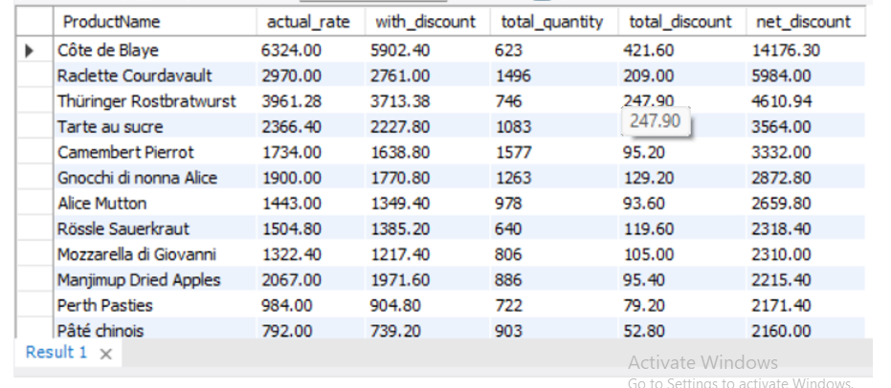
Inference-:
We get the output for the total discount for the each product name.
Also we get total amount saved for the each order with respect to the
Highest to lowest amount.

Slide 31
Project Flow
Question 2-:Mr. Kavin want to become a supplier. He got the database
of "Richard's Supply" for reference. Help him to pick: a. List few products that he should choose based on demand.
Code:- select productname , sum(quantity) from product p join
orderitem o on p.id=productid group by
productnameorder by sum(quantity) desc limit 5;

Slide 32
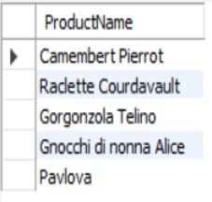
Solution-:
We want to list of few product which in demand.
According to the case we use the total quantity of the product.
We use the sub-query for it solve the problem. Using the group by clause we grouped the product with respect to the productname and
order the product by the demand in the market.
Inference-:
We suggest these 5 products to Mr.Kavin that they should go for to commence his business.

Slide 33
b. Who will be the competitors for him for the products suggested in above questions.
Code:- select * from supplier where id in
(select supplierid from product p join
(select p.id from
product p join orderitem o on p.id=productid
group by productnameorder by
sum(quantity)desc limit 5) as t on p.id=t.id) ;

Slide 34
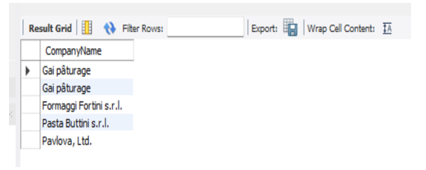
Solution-:
To find the competitors for the Mr. Kavin we use the above questions logic
For it . By using inner join we get the common data of the table supplier and product. Using the nested sub-query for the solving the problem. We sorted the
Data with respect to the product. It can be help to find the competitors.
Inference-:
We get the list of the competitors for the Mr. Kavin .
These 4 companies are the competitors fro Mr.Kavin.
They manufacture the content which is in huge demand.

Slide 35
Project Flow
Question 3-: Create a combined list to display customers
and suppliers details considering the following criteria
a. Both customer and supplier belong to the same country
b. Customer who does not have supplier in their country
c. Supplier who does not have customer in their country
Code:-create table if not exists temp select * from
(select CustomerId, CONCAT(FirstName,' ',LastName) cust_name,
T1.City cust_city, T1.Country cust_country, ContactName, CompanyName,
T5.City supp_city, T5.Country supp_country from customer T1 join orders T2

Slide 36
on T1.Id = T2.CustomerIdjoin orderitem T3 on T3.OrderId = T2.Id join product
T4 on T3.ProductId = T4.Idjoin supplier T5 on T5.Id = T4.SupplierId) R1;
Solution-:
To create the combined list to display customers and suppliers details we created the table by using the joins. We get the common data from tables customers, orders, products and supplier etc.
a. Both customer and supplier belong to the same country
Code-: select cust_name customer, ContactName supplier, supp_city, supp_country from temp where cust_name<>ContactName and cust_city=supp_city;

Slide 37
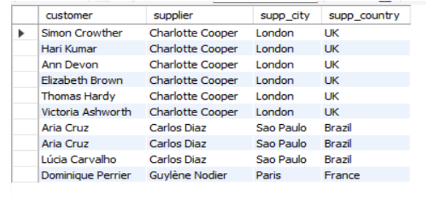
Solution-:
We have to find the customer and supplier which have same country.
By using select query we can find it giving condition to it that the
Customer and supplier have same country.

Slide 38
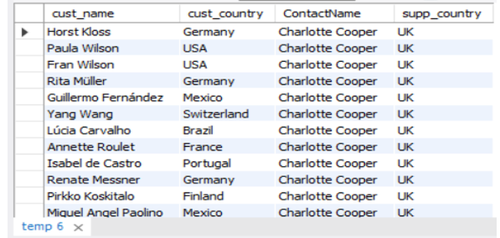
b. Customer who does not have supplier in their country.
Code-:
select cust_name, cust_country, ContactName, supp_country from temp where cust_country<>supp_country;
Solution-:
We used the previous question logic for this just by applying the not condition
We get the customer who does not have supplier in their country.

Slide 39
c. Supplier who does not have customer in their country.
Code-:
select cust_name, cust_country, ContactName, supp_country from tempwhere cust_country<>supp_country;
Solution-:
This is similar question like question (b). By using the same condition we get the output. We get the supplier who does not have customer in their country.

Slide 40
Project Flow
Question 4-: Every supplier supplies specific products to the customers.
Create a view of suppliers and total sales made by their products and
write a query on this view to find out top 2 suppliers
(using windows function) in each country by total sales done by the products.
Code:- create view suppliers as
( select *,dense_rank() over(order by COUNRY_TOT_AMNT desc)
'RANK‘ FROM(select ContactName, ProductName,
SUM(total_amount) COUNRY_TOT_AMNT, Countryfrom(select CompanyName, ContactName, ProductName, SUM(T2.UnitPrice) actual,

Slide 41
SUM(T3.UnitPrice) discount, SUM(TotalAmount) total_amount,
Country from supplier T1 join product T2 on T1.Id = T2.SupplierId
join orderitem T3 on T3.ProductId = T2.Id join orders T4
on T4.Id = T3.OrderId group by ContactName
order by SUM(TotalAmount) desc) R1 group by Country) R2 LIMIT 2);
Solution-:
We have to create view of supplier by using the DDL command ‘create’.
To giving the rank for supplier with respect to each country.
According to the condition we have sorted the data.
By using the inner join we get the common data between the table. We can order it by maximum total sales by the supplier in each country. We giving the highest
Priority by the sales .

Slide 42
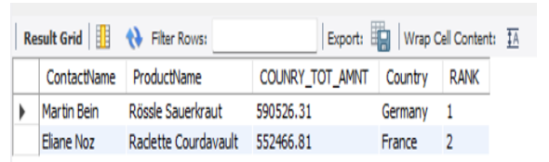
Inference-:
We get the view of the top 2 supplier in the country.

Slide 43
Project Flow
Question 5-: Find out for which products, UK is dependent on
other countries for the supply. List the countries
which are supplying these products in the same list.
Code:-
select ProductName from (select ProductName, Country from
supplier s join product p on s.Id = p.SupplierId) R1where ProductName
not in (select ProductName from supplier s join product p
on s.Id = p.SupplierId where Country like 'UK') ;

Slide 44
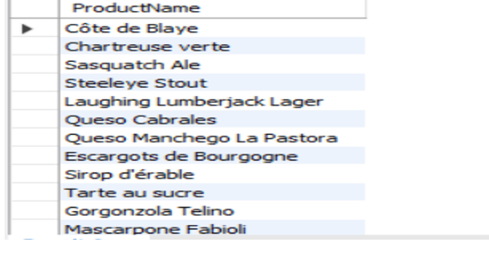
Solution-:
By using the nested we gets the output. We have to use the select clause for
Fetching the columns from the table after that by using the joins we get common
data in both the table. We use this common data for solve the problem. We have to
find the country ‘UK ’ in this table using the where conditions we apply it on.
We use the wildcard filtering using like operator.
Inference-: UK is dependent on these products, hence these products do not get manufactured in UK

Slide 45
Project Flow
Question 6-: Create two tables as ‘customer’ and ‘customer_backup’ as follow -
‘customer’ table attributes - Id, FirstName,LastName,Phone
‘customer_backup’ table attributes - Id, FirstName,LastName,Phone
Create a trigger in such a way that It should insert the details
into the ‘customer_backup’ table when you delete the
record from the ‘customer’ table automatically.
Code:- create table customer1(id int,firstname varchar(20),lastname varchar(20),
Phone varchar(20));create table customer_backup(id int,firstname varchar(20),
lastname varchar(20),Phone varchar(20));

Slide 46
insert into customer1 values (1,'Manoj','kale','1293832480'),
(2,'Vinit','Pawar','129385480');
delimiter | create trigger insert_into_trigger_customer
before delete on customer1
for each row begin
insert into customer_backup
set id=old.id, firstname=old.firstname, lastname=old.lastname, phone=old.phone; End; | delimiter ;
select * from customer1; select * from customer_backup;
delete from customer1 where id=1;

Slide 47
Solution-:
We have to create the tables customer1 and customer_backup tables.
Using the insert query we inserted the values in the customer1 table.
We have to create the trigger with the name insert_into_trigger_customer .
By creating the trigger we have to set the old column with new.
When we deletes the some record from the table customer it will get stored in the
Customer_backup table.
Inference-:
We get the backup if the any record will be deleted from the parent table.

Slide 48
Conclusion-:
This project we shows how to established relation between the tables, with the help of ER diagram AND show how relationship are established with the concepts of primary and foreign key with a table .
This mini project analysed a company’s strategy and management with the help of example similar problems encountered by manpower-intensive industries.
Though R&D is well-equipped with tools to manage its production and inventory, it still needs to build up safety stock in a better and cheaper way.
Management is the key factor that instructs employees how to set appropriate priorities. Nevertheless, R&D needs to improve operational processes so that manual mistakes can be reduced.

Slide 49
Thank You…..

